Slide 1
Asbestos Awareness Training
Surry Insurance Loss Prevention Services

Slide 2
Course Outline
The following topics will be covered:
Types & properties of asbestos
Uses of asbestos
Health effects of asbestos
General asbestos rule requirements

Slide 3
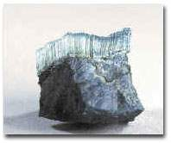
What is Asbestos?
Serpentine Rock (Chrysotile) - California State Rock

Slide 4
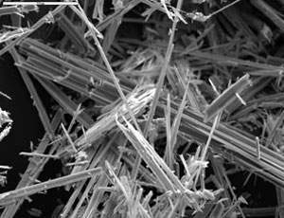
Close-up of Asbestos Fibers

Slide 5
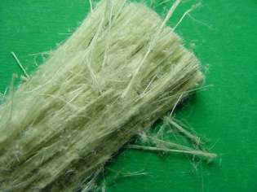
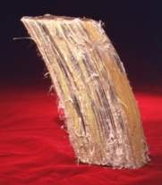
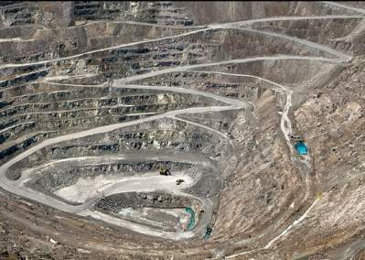
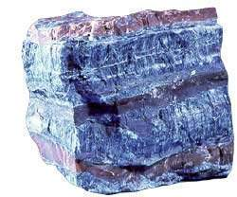
Common Types of Asbestos
Chrysotile – most common
“White Asbestos”
Amosite
“Brown Asbestos”
Crocidolite – least used
“Blue Asbestos”
Chrysotile asbestos mine in Canada

Slide 6
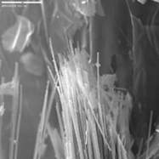
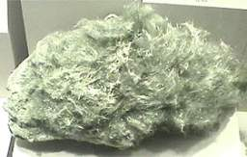
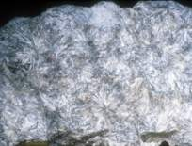
Other types of asbestos -
  Tremolite (Libby vermiculite mine-actually winchite-richterite)
Actinolite
Anthophyllite

Slide 7
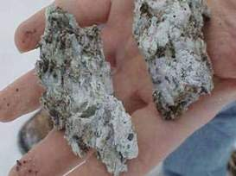
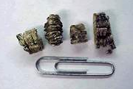
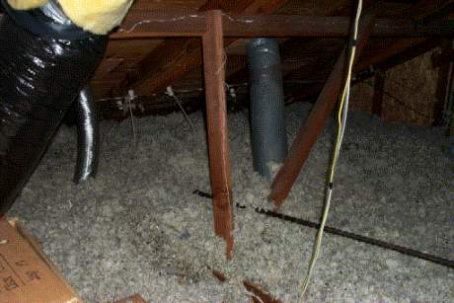
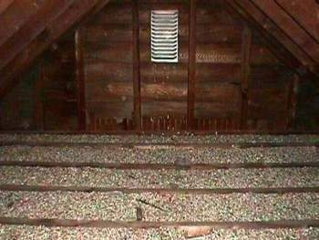
Vermiculite
Vermiculite ore
“Popped” Vermiculite
Vermiculite insulation in attics

Slide 8
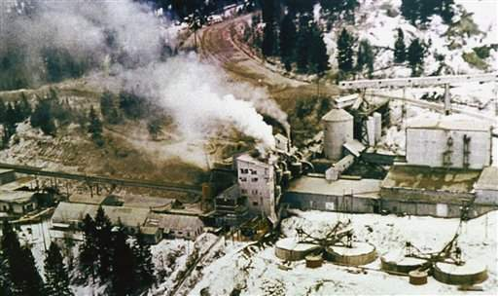
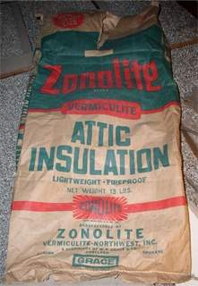
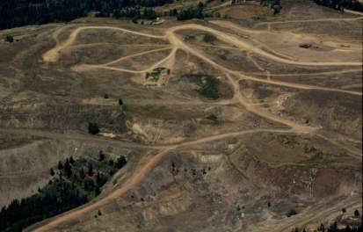
Libby Vermiculite Mine
Photo of operating Libby mine
Zonolite insulation
Libby Mine site today

Slide 9
Uses of Asbestos
Asbestos = “inextinguishable”
Egyptians; Greeks & Romans
Middle Ages
Industrial Revolution
Twentieth century –
*World War II + next 30 years

Slide 10
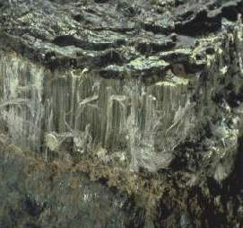
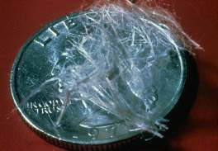
Properties of Asbestos
Naturally occurring fibrous minerals
Good tensile strength
Flexibility
Heat resistance
Electrical resistance
Good insulation
Chemical resistance
Asbestos ore

Slide 11
Some Asbestos-Containing Materials*
(This list does not include every product/material that may contain asbestos. It is intended as a general guide to show which types of materials may contain asbestos.)
Cement Pipes
Cement Wallboard
Cement Siding
Asphalt Floor Tile
Vinyl Floor Tile
Vinyl Sheet Flooring
Flooring Backing
Acoustical Plaster
Decorative Plaster
Textured Paints/Coatings
Ceiling Tiles and Lay-in Panels
Spray-Applied Insulation
Blown-in Insulation
Fireproofing Materials
Taping Compounds (thermal)
High Temperature Gaskets
Laboratory Hoods/Table Tops
Laboratory Gloves
Fire Blankets
Fire Curtains
* Source: EPA

Slide 12
Some Asbestos-Containing Materials
(Continued)
Elevator Equipment Panels
Elevator Brake Shoes
HVAC Duct Insulation
Boiler Insulation
Ductwork Flexible Fabric Connections
Cooling Towers
Pipe Insulation (corrugated air-cell, block, etc.)
Heating and Electrical Ducts
Electrical Panel Partitions
Electric Wiring Insulation
Chalkboards
Roofing Shingles
Roofing Felt
Base Flashing
Thermal Paper Products
Fire Doors
Caulking/Putties
Adhesives
Wallboard
Joint Compounds
Vinyl Wall Coverings
Spackling Compounds

Slide 13
Asbestos is an Inhalation Hazard
Airborne asbestos fibers inhaled deep into the lung can cause damage.
Respirable fibers are inhaled and deposited in the lungs
Body’s defense mechanisms cannot break down the fibers
Fibers cause damage to respiratory system
Damage occurs in the alveoli

Slide 14
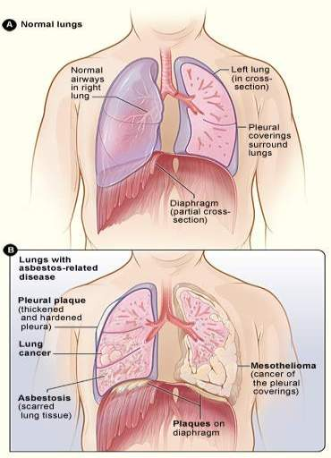
Asbestos-related diseases
Asbestos can cause disabling respiratory disease and various types of cancers if the fibers are inhaled.
- Asbestosis
- Lung Cancer
- Mesothelioma
- Other cancers

Slide 15
Smoking and Asbestos
Lung Cancer Risks
70 per 100,000
lung cancer deaths
in general population
5x higher risk than general population
10x higher risk
50x to 90x higher risk

Slide 16
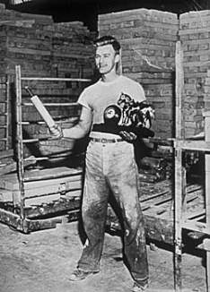
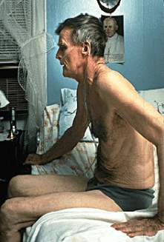
Asbestosis Example
Photos ©RAVANESI@2000
Joe Darabant, 1949.
Covered with chrysotile asbestos fibers. Worked for 30+ years at the Johns-Manville Plant in New Jersey, cutting asbestos shingles and making asbestos block and pipe-covering materials.
Joe, 1989.
Forced to retire in 1974 at age 50 from poor health; he died from asbestosis in 1990 at age 66.

Slide 17
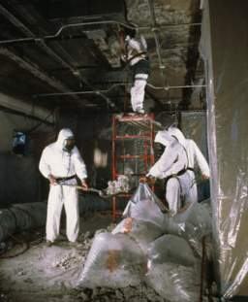
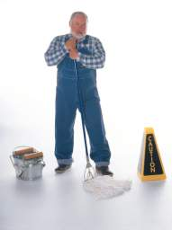
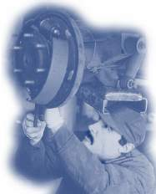
Current worker exposure to asbestos
An estimated 1.3 million workers are exposed in U.S. today.
In the construction industry, removal renovation and demolition have heaviest exposures.
In general industry, exposure can occur in:
  manufacture of asbestos products
  automotive brake and clutch repair
  housekeeping and custodial work

Slide 18
Where could you be exposed to asbestos?
Asbestos had a variety of uses in building construction completed before 1981. You could be exposed to asbestos during inspection of the following activities in these older buildings:
Asbestos removal projects
Building insulation maintenance or repair
Heating and air conditioning maintenance and repair
Insulated piping maintenance repair
Floor tile or flooring replacement or repair
Roofing or siding replacement or repair
Wallboard(sheetrock) or wall plaster replacement or repair
“Popcorn ceiling” replacement or repair
Janitorial or maintenance work done in pre-1981 buildings
Building demolition

Slide 19
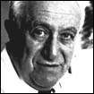
Brief history of U.S. asbestos regulation
British physicians noted that asbestos workers developed lung disease in early 1900’s.
Lung disease noted in American asbestos workers in 1930’s. Some companies actively suppressed this information.
Dr. Irving Selikoff at Mt. Sinai Hospital in New York began studying asbestos workers in 1960’s.
His published research led OSHA to adopt specific standard on asbestos in early 1970’s.
OSHA lowered the PEL for asbestos several times through 1970’s, 1980’s and 1990’s.

Slide 20
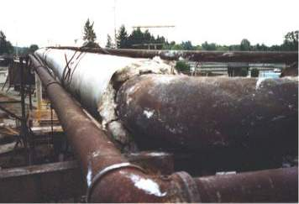
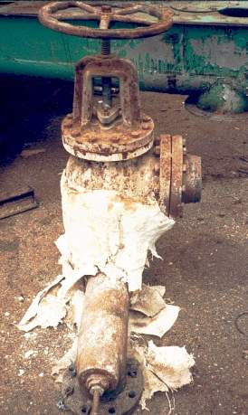
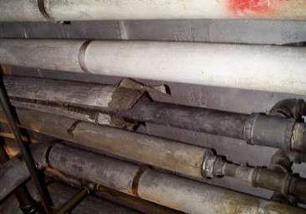
Thermal System Insulation (TSI)
Asbestos insulation on outdoor pipe
Air cell pipes
Damaged insulation on control valve

Slide 21
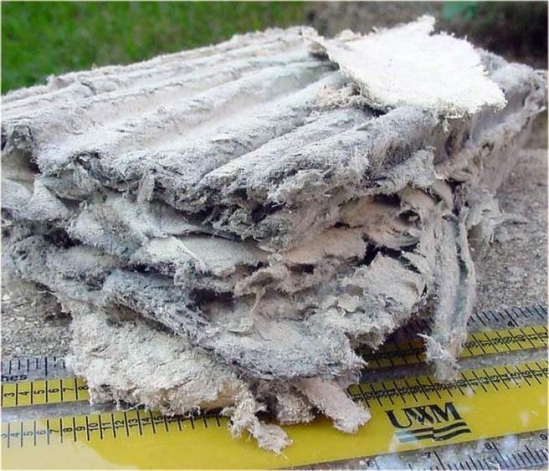
Thermal system insulation close-up

Slide 22
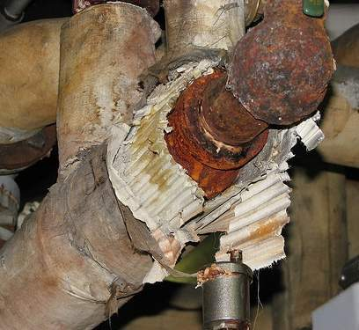
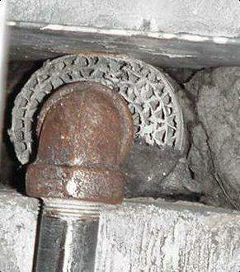
Asbestos air cell insulation (pipe insulation)
Visible asbestos fibers

Slide 23
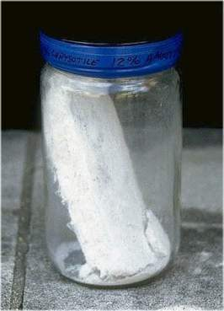
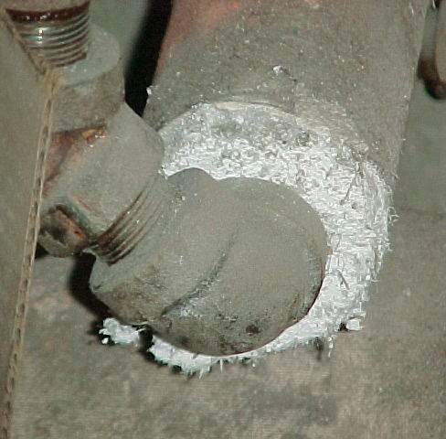
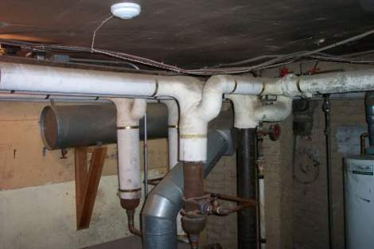
“Mag” Pipe Insulation

Slide 24
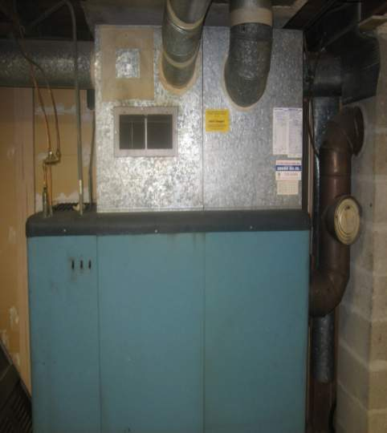
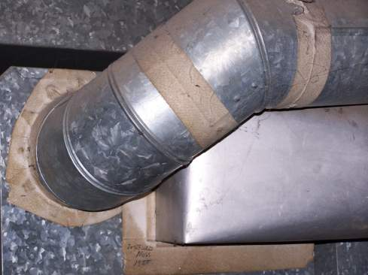
Asbestos Duct Tape

Slide 25
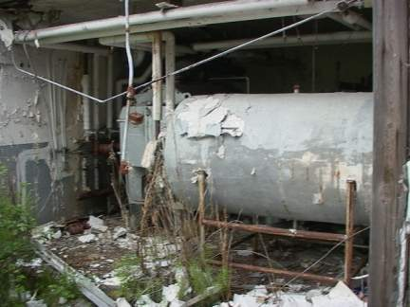
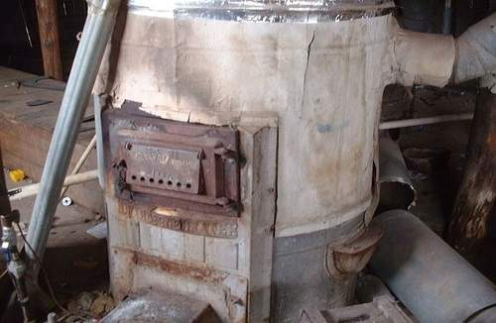
More Thermal System Insulation
Asbestos insulated boiler
Asbestos insulated furnace

Slide 26
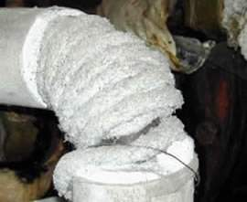
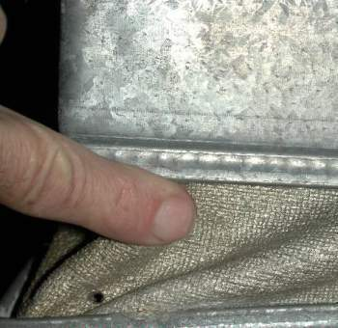
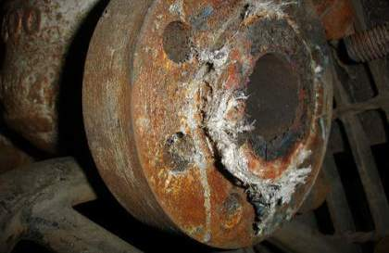
Asbestos gaskets, rope and packing – may be round, flat or impregnated with waterproof sealant
Asbestos rope
Damaged asbestos gasket
Asbestos fabric in HVAC system

Slide 27
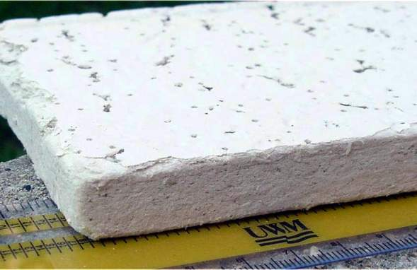
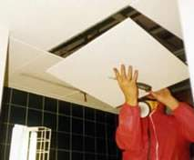
Asbestos Ceiling Tile
Tile close-up
Usually in 1’ by 1’ or 2’ by 4’ sizes

Slide 28
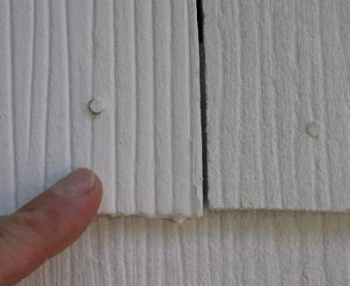
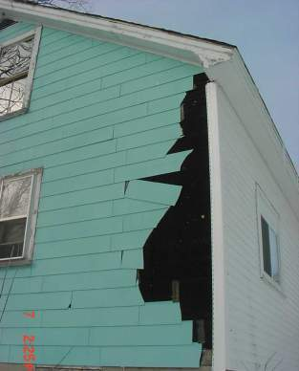
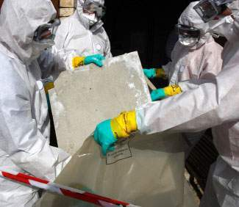
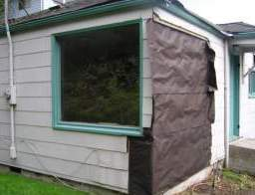
Asbestos shingle siding

Slide 29
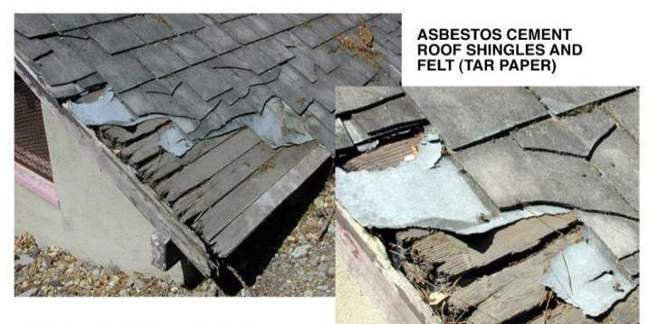
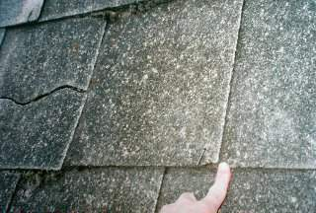
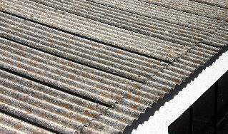
Asbestos Roofing Material

Slide 30



Vinyl asbestos and asphalt asbestos flooring

Slide 31


Asbestos Sheet Vinyl
Uncontrolled sheet vinyl removal

Slide 32




Surfacing Material
Sprayed-on surfacing material
Acoustical material

Slide 33

Spray-on insulation containing asbestos

Slide 34


Asbestos fireproofing in ceiling and above dropped ceiling

Slide 35


Popcorn Ceiling Material
###
Uncontrolled popcorn ceiling removal job
damaged and friable popcorn ceiling material

Slide 36


Chimney flue packing (mud) containing asbestos

Slide 37

Asbestos Mill Board

Slide 38



Asbestos Brake Pads & Discs

Slide 39


Asbestos in joint compound and plaster

Slide 40


How do asbestos fibers get in the air?
Asbestos is most hazardous when it is FRIABLE.
Physical disturbance of asbestos-containing materials (ACM) suspends fibers in the air.
Friable: can be easily crumbled or crushed by hand, releasing fibers into the air
Very small fibers stay in the air for long periods
Damaged or deteriorated ACM increases friability

Slide 41

How do asbestos fibers get in the air?
Some typical activities and situations that can result in asbestos exposure:
Mechanical action on ACM (cutting, sawing, grinding, sanding, drilling, buffing, etc.)
Disturbing/breaking ceiling tiles
Removing/replacing insulation
Disturbing sprayed-on asbestos
Asbestos abatement projects
Un-surveyed construction projects on older buildings
Debris from disturbance of “popcorn” ceiling

Slide 42
“ACM” and “PACM”
Asbestos Containing Material
Any material containing more than 1% asbestos by weight.
Presumed Asbestos Containing Material
Surfacing materials
Thermal System Insulation
Flooring
Installed prior to 1981
Must be handled as ACM unless proved otherwise

Slide 43



Communication of Hazards
Warning Signs
  for regulated areas
  visible before entering
Warning Labels
  attached to all products and their containers
AVOID BREATHING AIRBORNE ASBESTOS FIBERS

Slide 44


Custodial/Light maintenance work
Housekeeping and building maintenance activities may expose workers to asbestos fibers if ACM/PACM is disturbed.
Activities:
  sweeping
  vacuuming
  cleaning
  changing lights
Damaged asbestos pipe insulation
Some materials of concern:
  vinyl asbestos tile
  exposed piping
  exposed fireproofing
  popcorn ceiling
Asbestos debris on floor

Slide 45




Custodial/Light maintenance work
Dry dust or sweep surfaces, ceilings, walls, or floors
Disturb ACM when replacing light bulbs, etc.
DO NOT:
Pin or hang pictures, plants, or objects on walls or from ceilings covered with asbestos materials
Sand asbestos floor tiles or backing material

Slide 46



Custodial/Light maintenance work
DO:
Dust with a damp cloth
Use only a HEPA-filtered vacuum to clean up asbestos debris
Wet mop floors

Slide 47

Steve McQueen
McQueen developed a persistent cough in 1978. He gave up cigarettes and underwent antibiotic treatments without improvement. Shortness of breath grew more pronounced and on December 22, 1979, after filming The Hunter, a biopsy revealed pleural mesothelioma, a cancer associated with asbestos exposure for which there is no known cure.
A few months later, McQueen gave a medical interview in which he blamed his condition on asbestos exposure. McQueen believed that asbestos used in movie sound stage insulation and race-drivers' protective suits and helmets could have been involved, but he thought it more likely that his illness was a direct result of massive exposure while removing asbestos lagging from pipes aboard a troop ship while in the Marines.
50 years old when he died

Slide 48

Areas of Asbestos – High School

Slide 49

Areas of Asbestos – Middle School

Slide 50
Buildings That DO NOT Contain Asbestos Materials
- Perquimans Central School
- Board of Education
- Transportation Department
- Maintenance Department
- Hertford Grammar (All ACM has been Abated 2021 – 2022 School Year)

Slide 51
Thank you!

